Slide 1
Community Health update
Emily Kuenstler, Community Health Director and
Karen Johnson, Community Health Specialist

Slide 2
About Community Health
Essentia Health’s Community Health Department focuses on improving the health of the communities we’re privileged to serve
Primary functions
Evaluates community health needs
Develops and implements programs
Fosters connections with community partners
Shares resources to benefit our patients

Slide 3
Community Health Needs Assessments
One area our Community Health Department focuses on is our Community Health Needs Assessments (CHNAs)
It’s a community-based process that uses quantitative and qualitative methods to collect and analyze data to understand health needs within each local hospital’s service area
Assess the health needs and disparities
Prioritize health needs
Design a strategy to reflect optimal usage of resources
Engage our community partners in all aspects of the process

Slide 4
Why we are required do CHNAs
The Patient Protection and Affordable Care Act (PPACA) requires not-for-profit hospitals to provide a Community Health Needs Assessment (CHNA) every three years
Requires adoption of an implementation strategy for identified needs
Includes input from community members and public health experts
Must be made public

Slide 5
Why we want to do CHNAs
Provides a structure for community input
Develops relationships with the community and a shared vision
Develops an implementation plan to work collaboratively to address priority health needs
Aligns with our Aspirational Aim to
Achieve Health & Vitality with our Communities

Slide 6
Timeline
Assess
Prioritize
Design
Finalize
April-Aug. 2021
Sept.-Dec. 2021
Jan.-April 2022
May-June 2022

Slide 7
Guiding principles
Work toward solutions with multiple stakeholders to improve community health, such as schools, worksites and public health
Build trust through collaboration with community members
Prioritize sustainable evidence-based efforts around the greatest community good
Create clear, specific, realistic and action-oriented goals to improve health outcomes
New this year: Prioritize strategies that advance health equity, address structural barriers and/or reduce disparities
Notes:
Last guiding principle is new this year

Slide 8
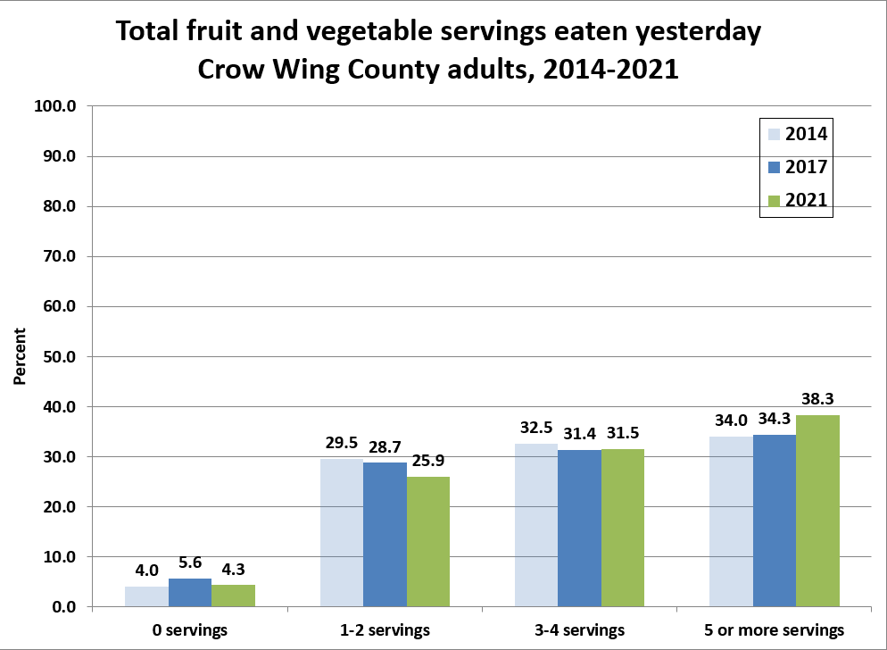
Crow Wing Energized
Several programs encouraged healthy eating through Crow Wing Energized
National Diabetes Prevention Program (1,464 participants since 2019)
Worksite Wellness coalition – Rethink Your Drink campaign
One Vegetable, One Community program
Notes:
Karen
Improvement shown on survey
Adults (18 and older) improved consumption of fruit and veggies per day

Slide 9
Crow Wing Energized
Several programs encouraged mental well-being through Crow Wing Energized
Make It Ok Stigma campaign
Sources of Strength program in the schools
Resilience Program with first responders
Community presentations on loss, grief, suicide, and mental well-being
Notes:
Karen

Slide 10
Community Health Needs Assessment
957
People completed the survey
14
Organizations participated in the process
4,000
Community members were mailed a survey
This is the first year we partnered with Cuyuna Regional Medical Center in Crosby
Notes:
Karen
First year we partnered with CRMC

Slide 11
Listening to our community
“Even though we say we are making mental illness awareness more available and acceptable, many people still feel shame in admitting help is needed.”
“Many people simply don’t know how to prepare fresh vegetables.”
“Not enough education in school at an early age to inform students of the dangers of tobacco use.”
“Stress and anxiety just completely overwhelm healthy lifestyle choices.”

Slide 12
2023 Brainerd Priority Health Needs

Slide 13
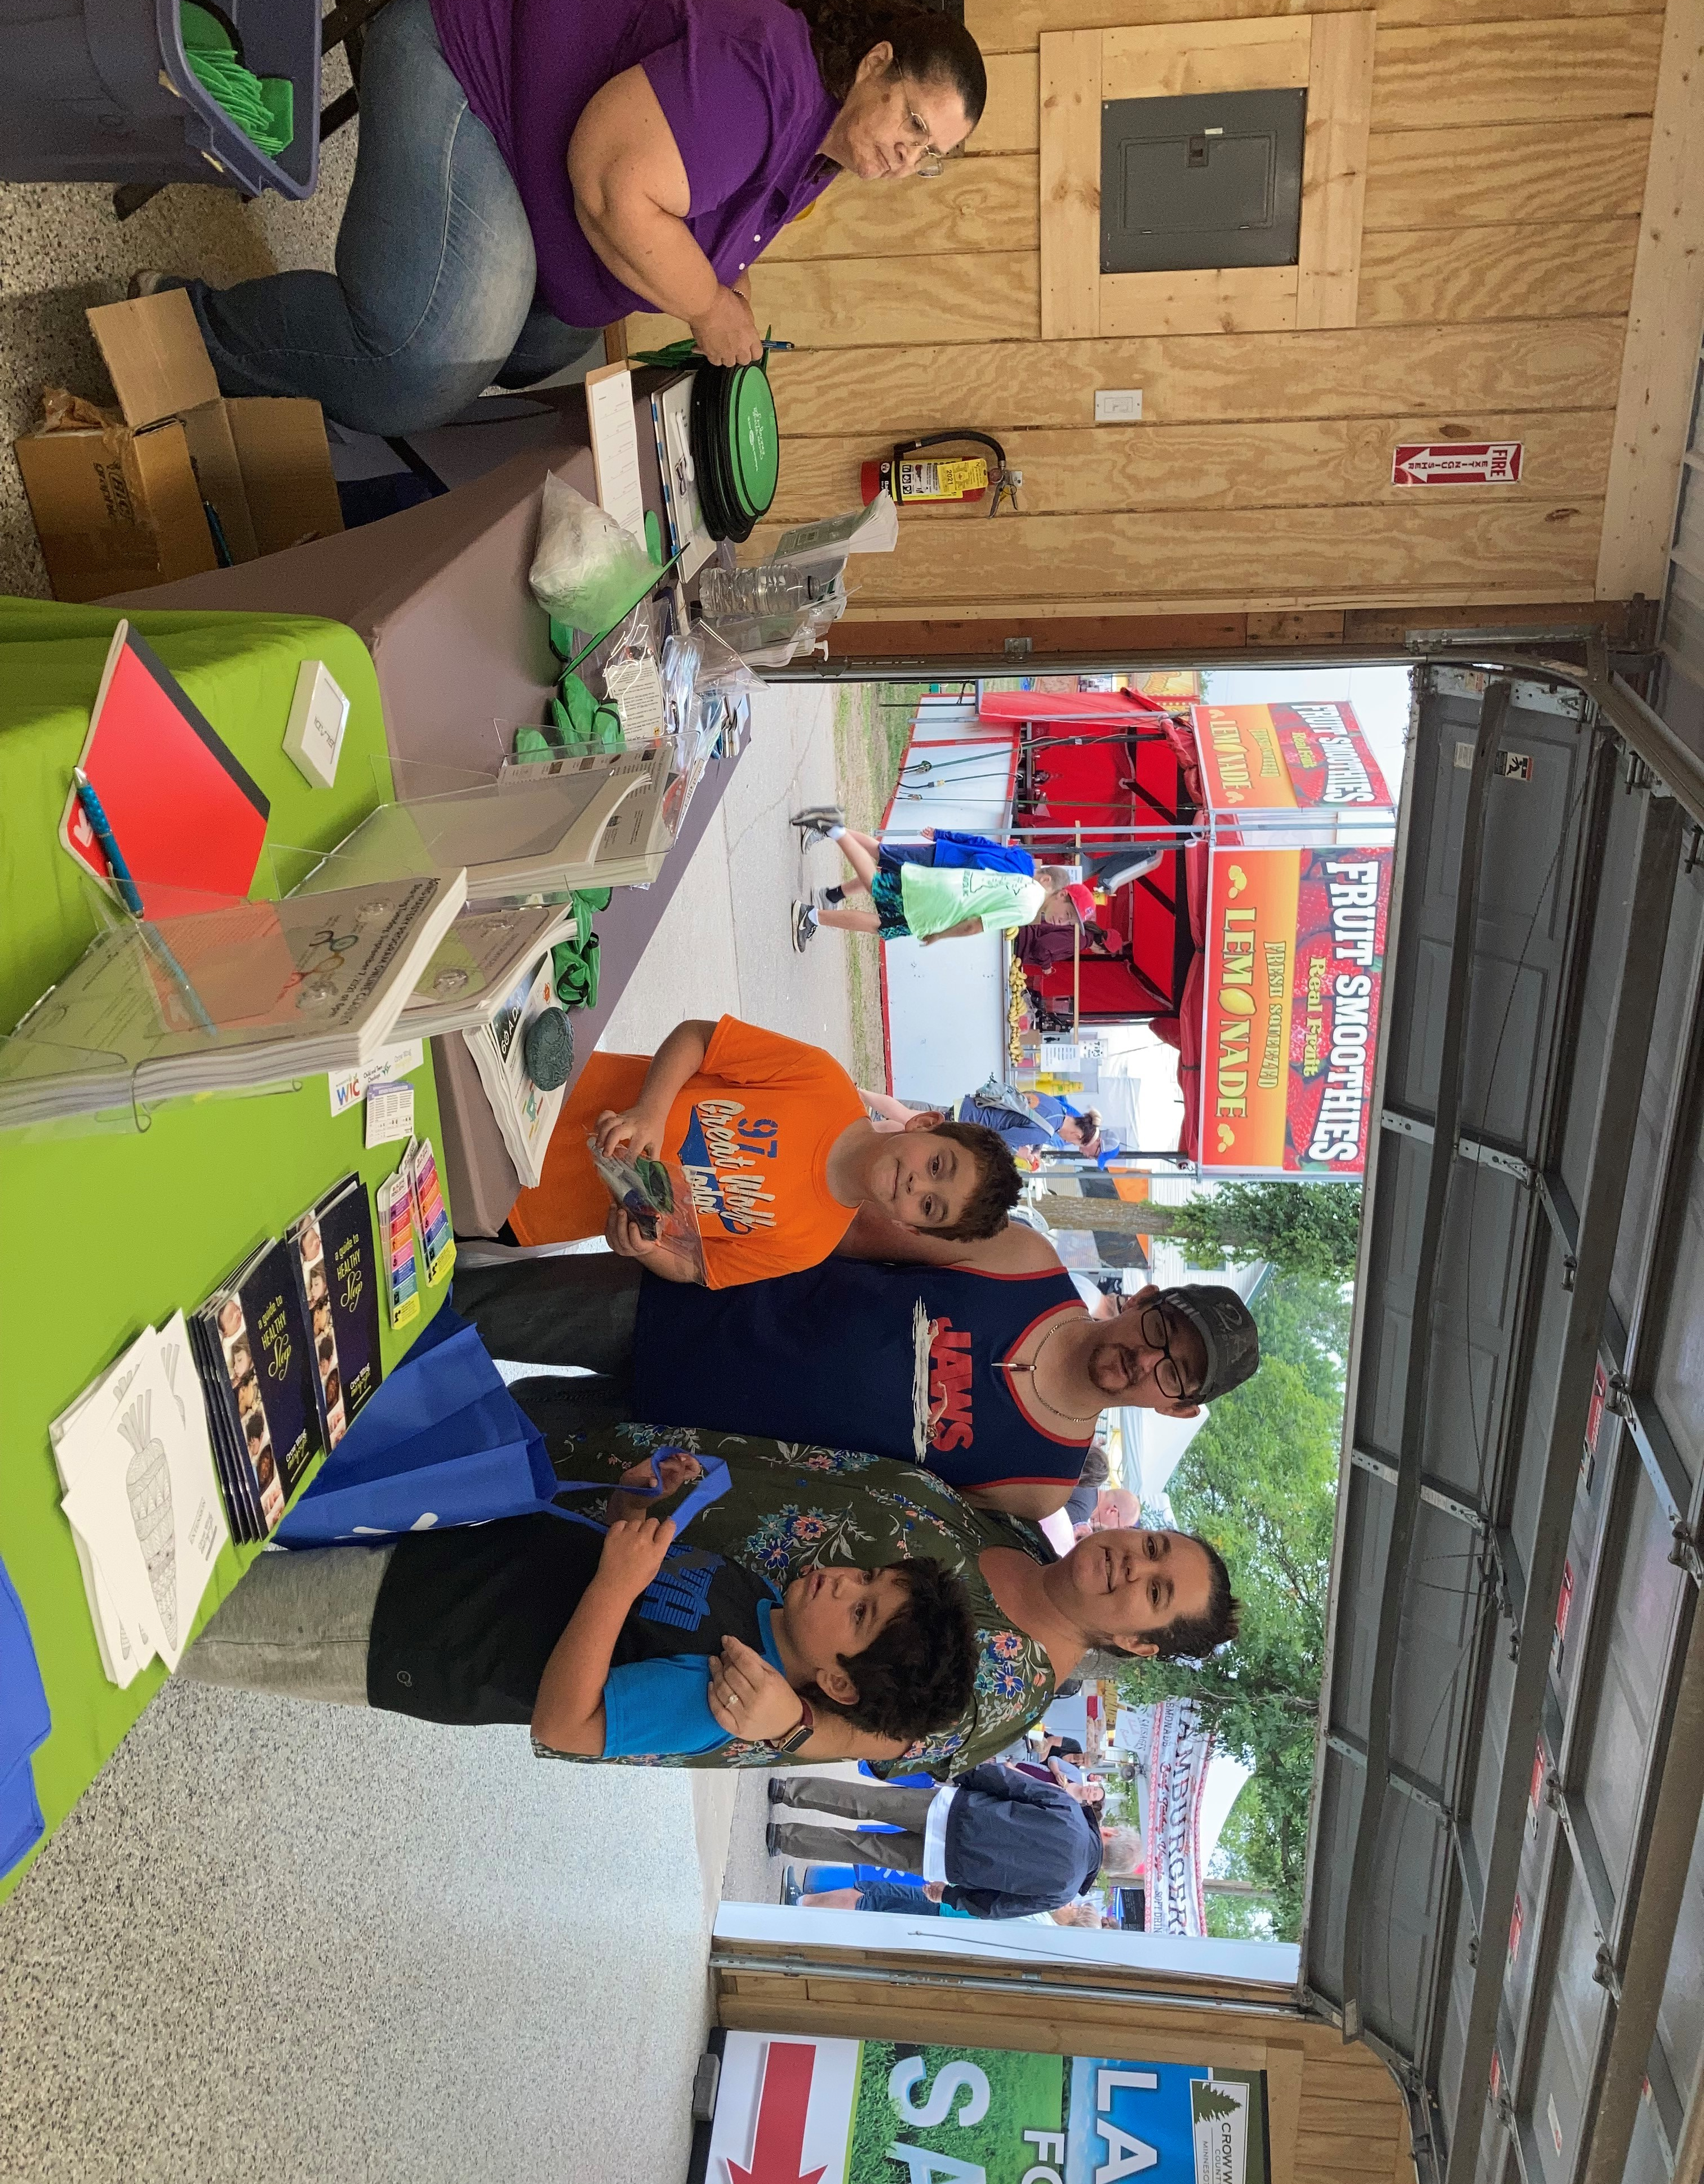
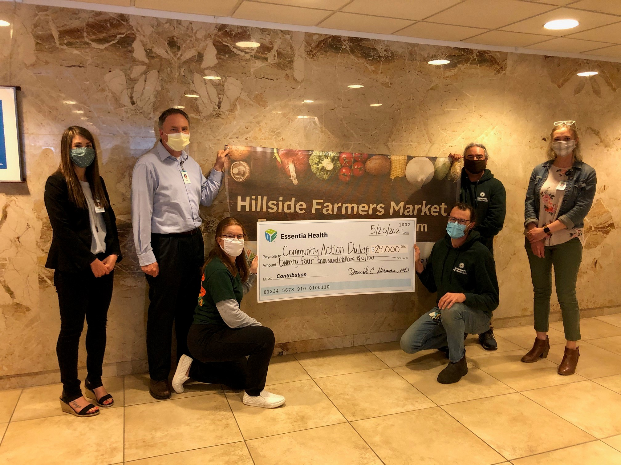
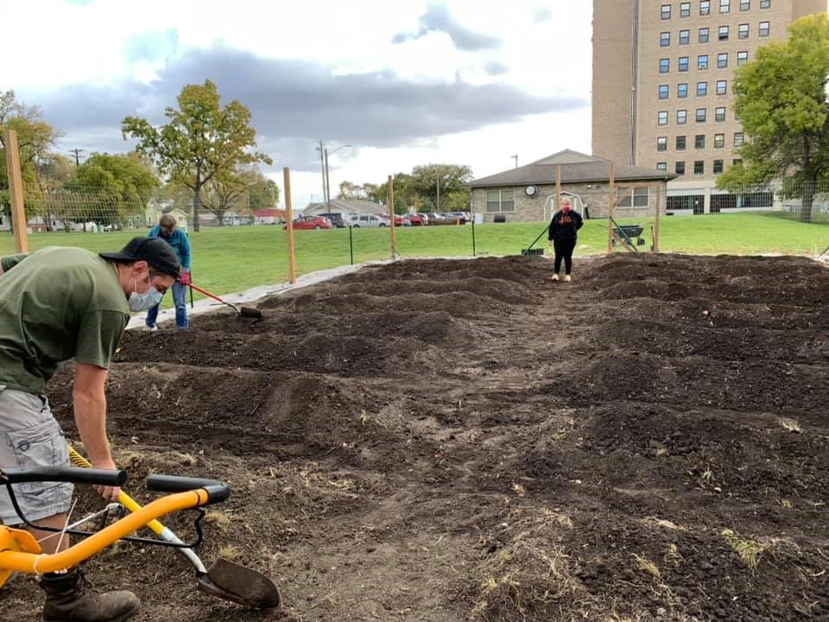
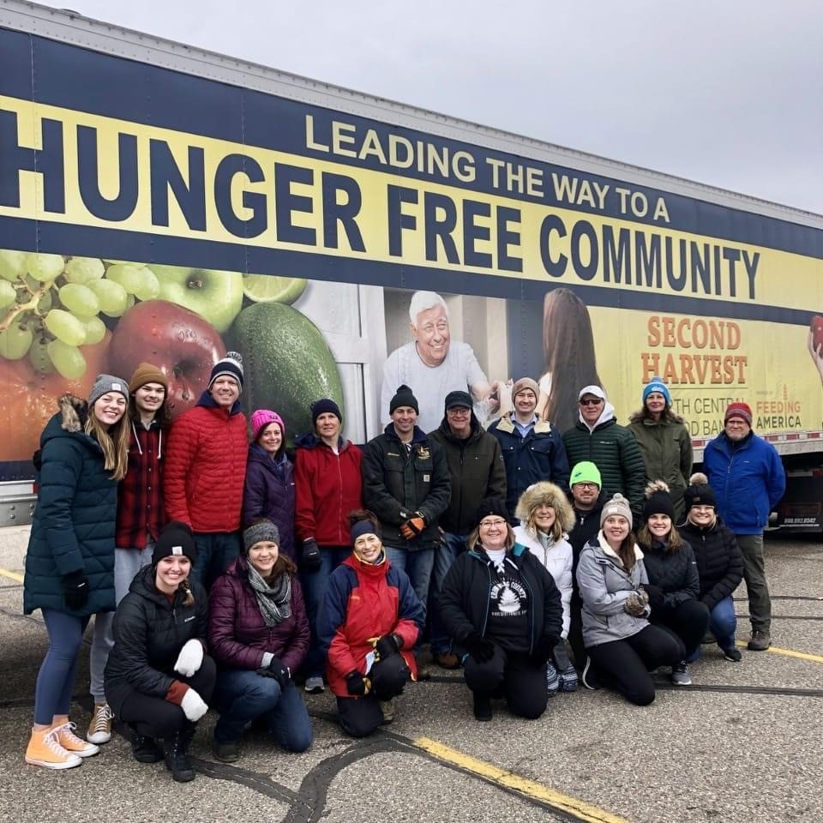
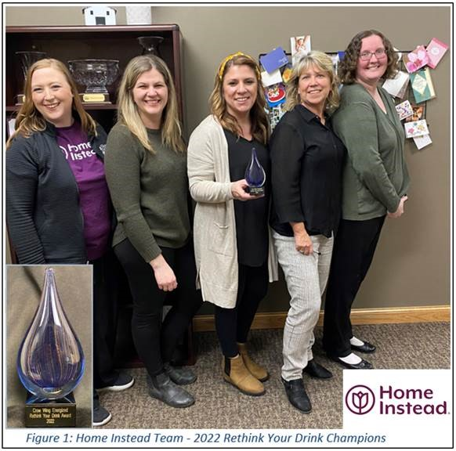
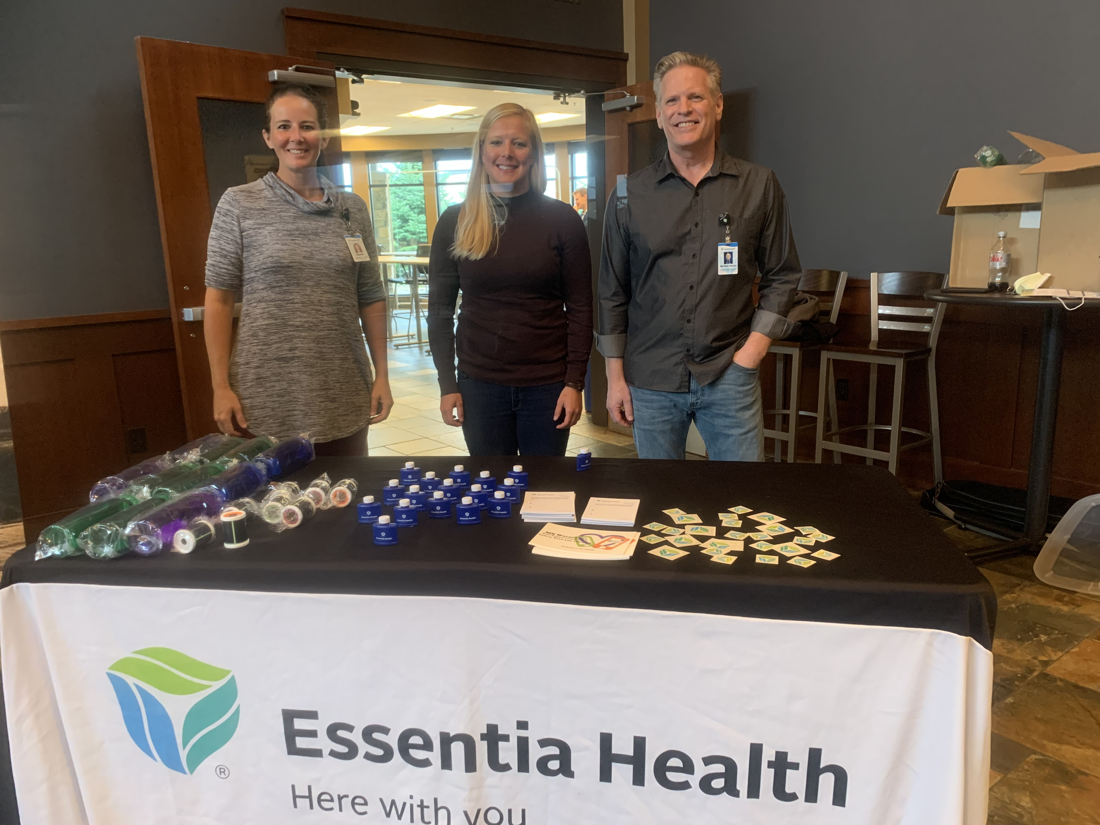
Success stories

Slide 14
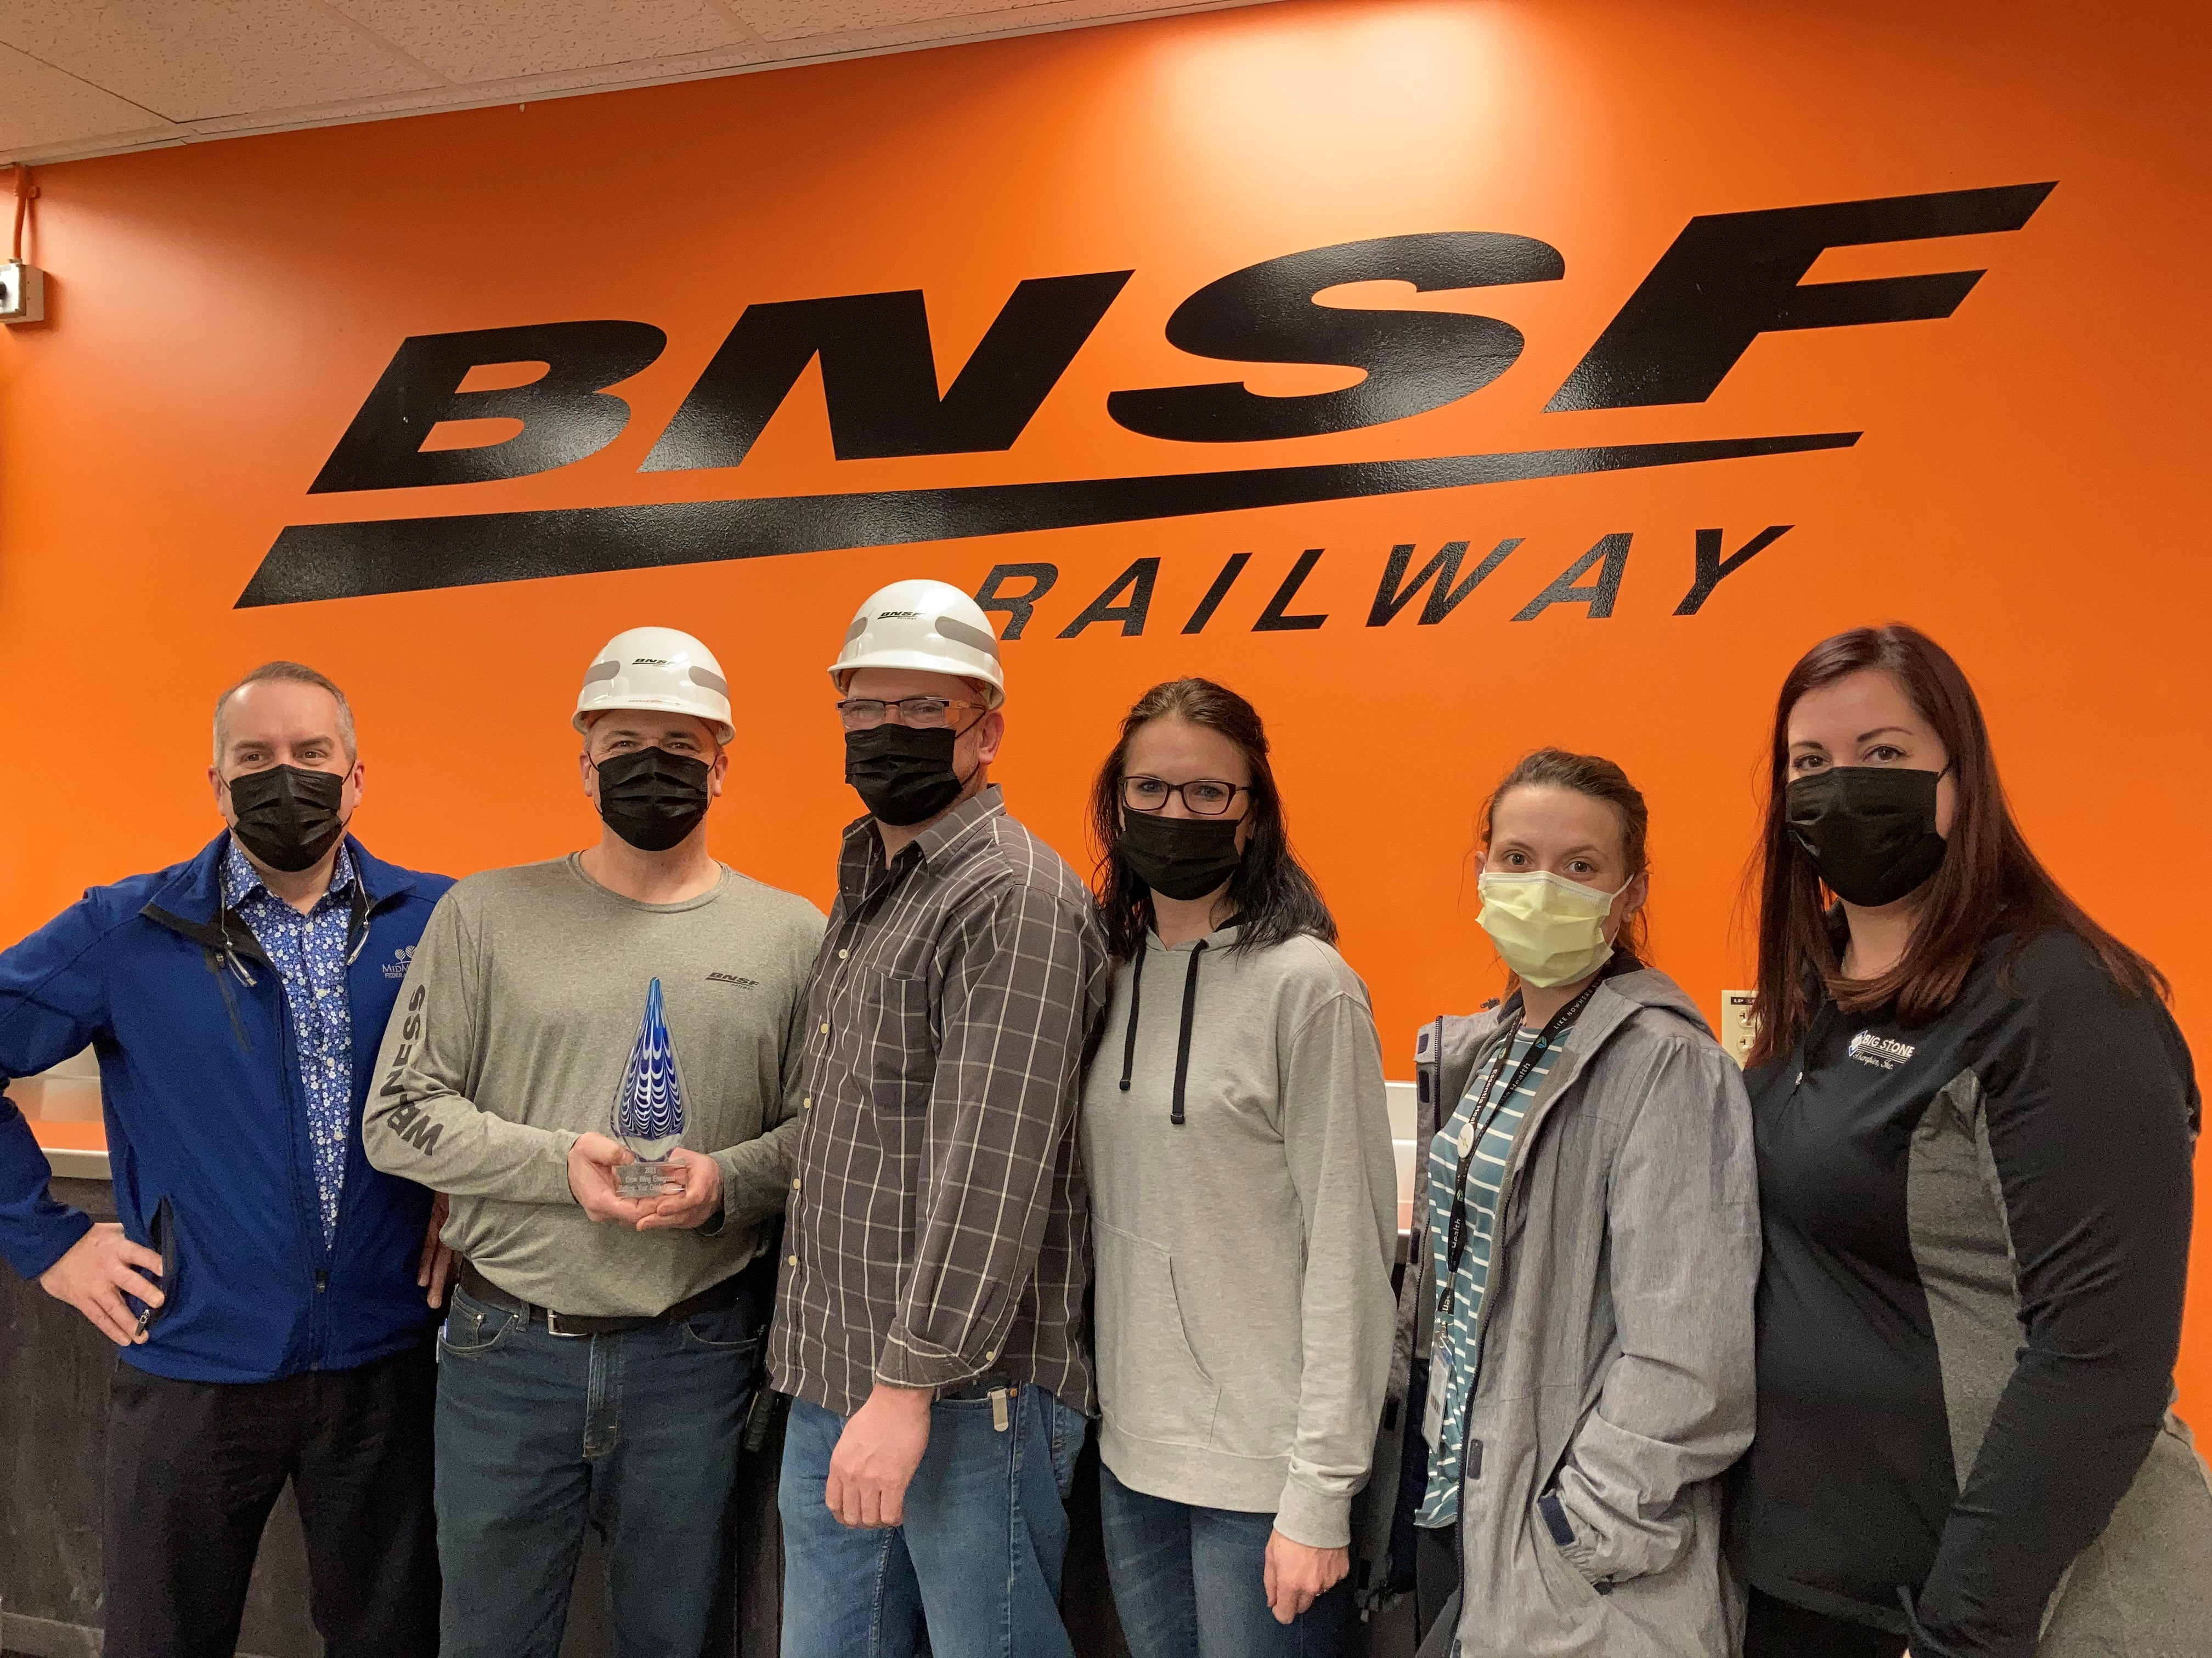
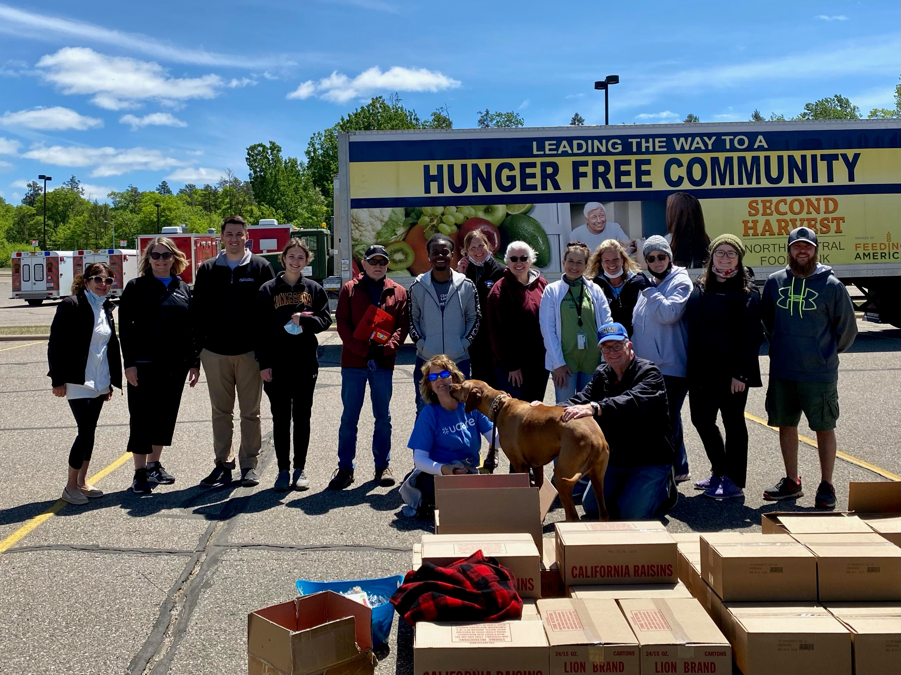
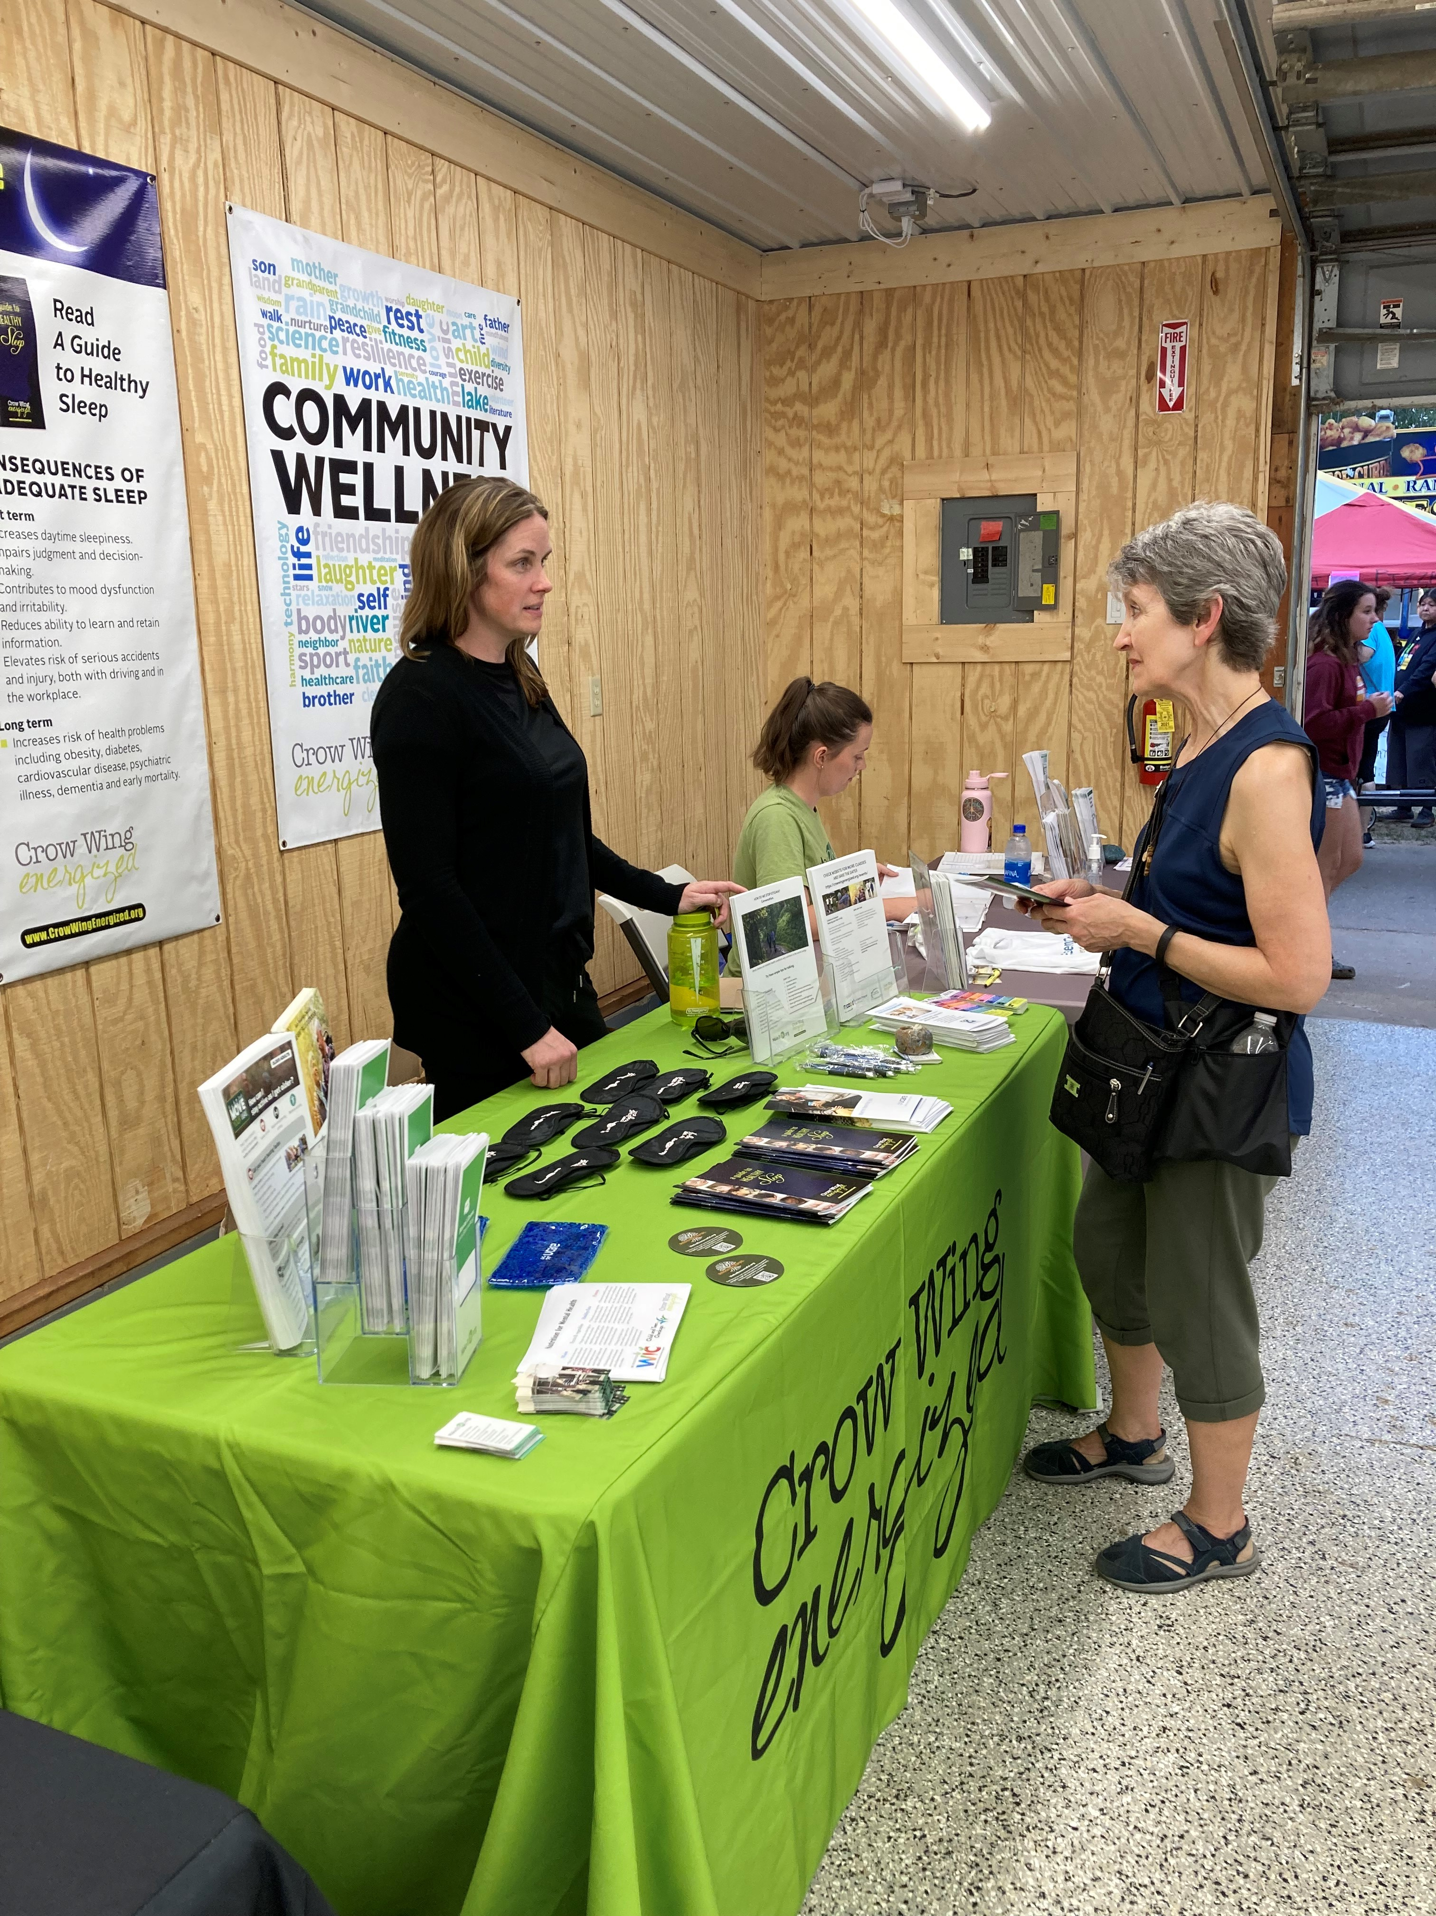
Success stories

